Slide 1
Robot Soccer Design
Team /-!#

Slide 2
Overview
Project overview
Action Item Review
Program Status
Next Steps

Slide 3
Overview
Project overview
Action Item Review
Program Status
Next Steps

Slide 4
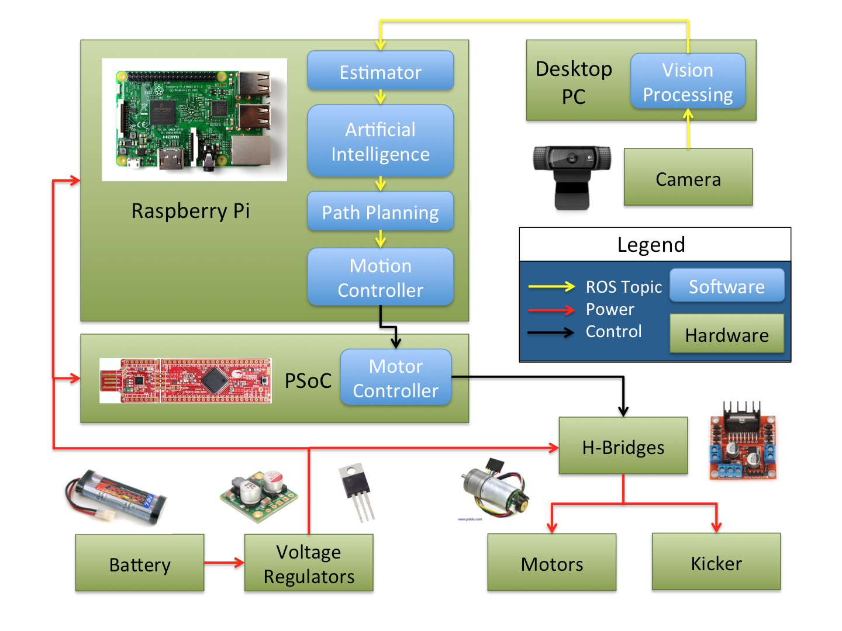
Project
Overview
Notes:
Hi ben

Slide 5
Overview
Project overview
Action Item Review
Program Status
Next Steps

Slide 6
Action Item Review
Software
Get a working vision node
Integrate with hardware
Continue to develop effective AI strategies
Hardware
Prepare for skills competition
Implement motion PID control
Get simple movements working well
Refine robot design - make it more robust and durable

Slide 7
Key Milestones: Previous Milestones
Skills Competition - February 15
Spinning
Move to specified point
Play Tournament - March 1
Intercept ball
Dribble ball

Slide 8
Overview
Project overview
Action Item Review
Program Status
Next Steps

Slide 9
Key Milestones: Competitions
Practice Competition 1 - March 13 (1v1)
Build new robot
Avoid other robots
Push ball into goal
Block the ball
Practice Competition 2 - March 22 (1v1)
Fix issues from competition 1
Kick the ball
Steal the ball

Slide 10
Key Milestones: Competitions
Practice Competition 3 - March 29 (2v2)
Build a second robot
Cooperative AI
Pass the ball
Practice Competition 4 - April 5 (2v2)
Fix issues from competition 3
System refinement
Final Competition - April 18
Score more points than the other team
Special effects

Slide 11
Overview
Project overview
Action Item Review
Program Status
Next Steps

Slide 12
Next Steps
Software
Make vision more robust
Implement estimator with lag compensation
Improve 1 and 2 player AI strategies
Hardware
Build second robot
Implement kicker
Make design more robust and durable

Slide 13
Questions?

